Slide 1
POTATO DISEASE PREDICTOR
Bharati Vidyapeeth College of Engineering, Navi Mumbai
Computer Engineering
Group members
Shivdhan Nikam (40)
Rushikesh Patil (48)
Soham Shinde (67)
Guide : Prof. Ranjit Mane

Slide 2
INTRODUCTION
Potato is one of the most used crops in the world and 2 ND most important crop in India. Our economy is largely affected by the production of potato. In India, potato is cultivated in almost all states and under very diverse Agro climate conditions.
About 85 per cent of potatoes are cultivated in Indo-Gangetic plains of North India. The states of Uttar Pradesh, West Bengal, Punjab, Bihar, and Gujarat accounted for more than 80 per cent share in total production. But its production is hampered due to different diseases of potato leaves.
These diseases decrease production and increase the price of potatoes. Our objective is to develop an automated system which will predict the potato disease and helps farmers to take necessary steps. In this work, we implemented a model based on Convolutional Neural Network (CNN) which provides 98.33% accurate result in predicting different diseases of potatoes.

Slide 3
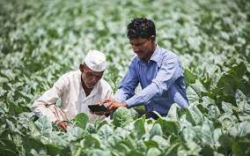
This is the maximum accuracy gained for only potato disease prediction to the best of our understanding. The system is cost effective, less time consuming and provides an efficient way of predicting potato diseases from leaves.
This will help the farmers and lead our country towards a digital agricultural system.

Slide 4
PROPOSED PROBLEM
The Farmers who grow potatoes suffer from serious financial standpoint losses each year which cause several diseases that affect potato plants.
To suffice the demand for food, at least 70 % increase from the present global yield must be produced. The presence of plant diseases imposes great challenges for farmers to meet the demand.
The diseases Early Blight and Late Blight are the most frequent. Early blight is caused by fungus and late blight is caused by specific micro-organisms and if farmers detect this disease early and apply appropriate treatment then it can save a lot of waste and prevent economical loss.

Slide 5
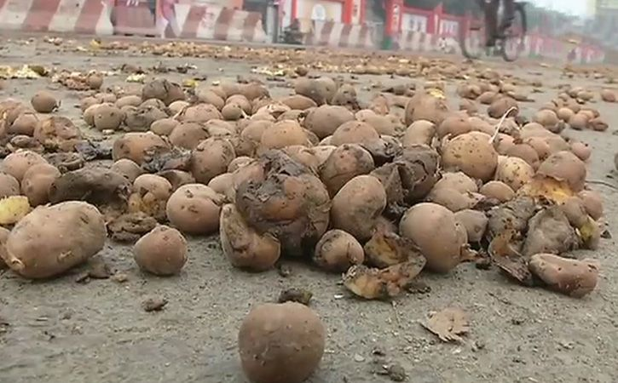
The treatments for early blight and late blight are a little different so it’s important that you accurately identify what kind of disease is there in that potato plant. Behind the scenes, we are going to use Convolutional Neural Network – Deep Learning to diagnose plant diseases.
Here, we’ll develop an end-to-end Deep Learning project in the field of agriculture. We will create a simple Image Classification Model that will categorize Potato Leaf Disease using a simple and classic Convolutional Neural Network Architecture.

Slide 6
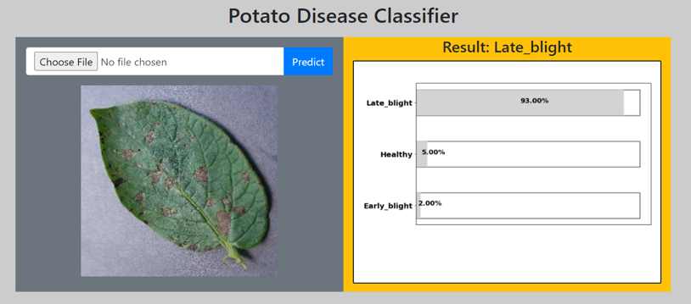
AIM AND SCOPE
Aim of this project is to develop an automated system which will predict the potato disease and helps farmers to take necessary steps.
In this work, we implemented a model based on Convolutional Neural Network (CNN) which provides 98.33% accurate result in predicting different diseases of potatoes.
Now a days it is very important to detect disease in a plant in the budding stage so that productivity and quality of the yield can be upgraded. Since disease detection needs a lot of expertise so it would be very beneficial if we could implement this system on the website in which farmers can click a picture of the leaf and send it to the server.
The server will automatically identify and classify the type of disease and send results back to the website.

Slide 7
LITERATURE REVIEW
Author | Title | Published at | Observation
Hassan Afzaal | Detection of a Potato Disease (Early Blight) Using Artificial Intelligence | 25 January 2021 | This study evaluated the potential of using machine vision in combination with deep learning (DL) to identify the early blight disease in real-time for potato production systems.
Javed Rashid | Multi-Level Deep Learning Model for Potato Leaf Disease Recognition | 06 February 2002 | Potato leaf disease detection in an early stage is challenging because of variations in crop species, crop diseases symptoms and environmental factors. These factors make it difficult to detect potato leaf diseases in the early stage.

Slide 8
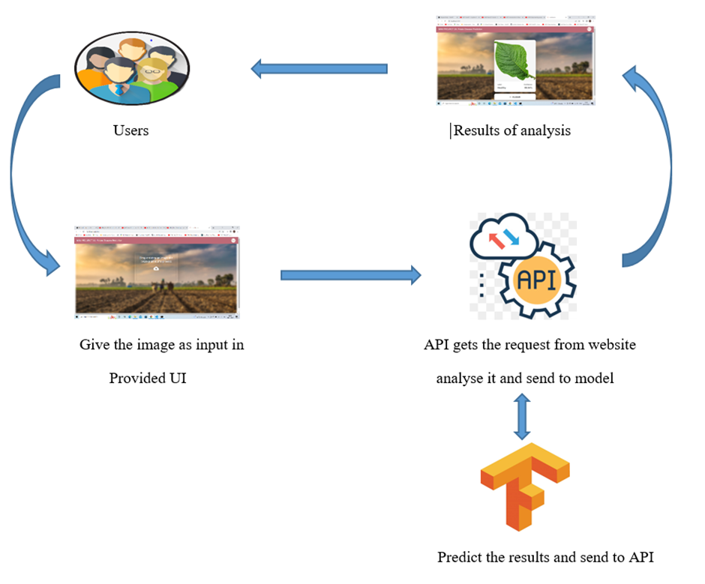
CONCEPTUAL FRAMEWORK:

Slide 9
PROPOSED SYSTEM
Load input image from directory
Splitting dataset into training, testing and validation
Data Augmentation
Feature extraction
Result
And Deployment of model into website
Performance Verification
Model Building and training

Slide 10

WORKFLOW:
Dataset Collection:
Kaggle is a data science and artificial intelligence platform.
It provides the various facilities and one of its major uses is it provides the large datasets on variety of the domains.
We use Plant Village Dataset more specifically Potato disease.

Slide 11
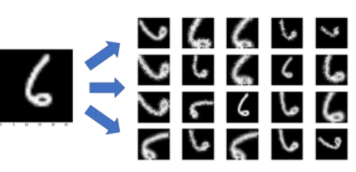
2. Data Processing and Augmentation:
Image augmentation plays a key role in building an effective image classifier. Some of the many image augmentation options are flipping the image vertically/horizontally, rotating through various angles and scaling the image.
Augmentations help increase the relevant data in a dataset. The size of each image in the Plant Village dataset is found to be 256 x 256 pixels. The data processing and image augmentation are done using the Keras deep-learning framework.
The augmentation options used for training are as follows:
• Random Rotation - To rotate a training image randomly over various angle
• Random flip - To flip a training image randomly over horizontal and vertical direction.

Slide 12
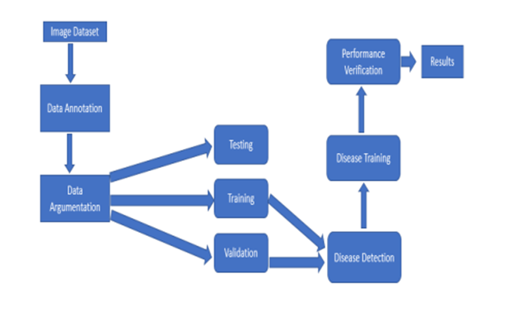
3. Steps related to image processing to detect plant diseases :
The whole process is divided into three stages:
Input images are first loaded in the program.
Segmentation pre-processing includes the process of image segmentation, image enhancement and color space conversion. First, the digital image of the image is enhanced with a filter. Then convert each image into an array. each image name is converted to a binary field.
CNN classifiers are trained to identify diseases in each plant class. Level 2 results are used to call up a classifier, which is trained to classify various diseases in that plant. If not present, the leaves are classified as "healthy".

Slide 13



TECHNOLOGY USED/ALGORITHM
TensorFlow
CNN
NumPy
Matplotlib
Fast API
React JS

Slide 14

The main advantage of Potato disease prediction is to protect crop production from quantitative losses.
Prediction of potato disease is essential as it may prove benefits in monitoring large fields of crops and thus automatically detect the symptoms of diseases as soon as they appear on plant leaves.
It can be implemented to increase crop productivity by ensuring the quality and quantity of the product.
It provides the better advancement and enhancement in computing classifiers of a neural network approach and provide better results.

Slide 15
The advantages of Potato disease prediction and classification is to provide best Agricultural productivity. This is one of the reason that disease Prediction in plants plays an important role in agriculture field.
It can recognize a plant disease which provides clues to identify and treat the disease in early stages.
This system will be capable of distinguish in a large no of different diseases in a less time.

Slide 16

CONCLUSION
With the advancement of technology and development on agricultural research there have been providing prototypes and models for plant leaf recognition and disease detection.
However, these models are optimized for small platforms due to computational operations. Moreover, this study only uses a total of 2152 images for the retrained model.
For future research, this model can be developed and improved by using a larger quantity of retraining images to achieve more accurate results.

Slide 17
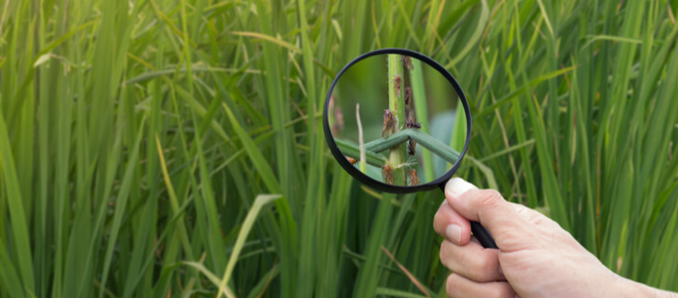
Compared with traditional image processing methods, which deal with plant diseases detection tasks in several steps and links, plant diseases detection methods based on deep learning unify them into end-to-end feature extraction, which has a broad development prospects and great potential.
Although plant diseases detection technology is developing rapidly, it has been moving from academic research to agricultural application, there is still a certain distance from the mature application in the real natural environment, and there are still some problems to be solved.

Slide 18
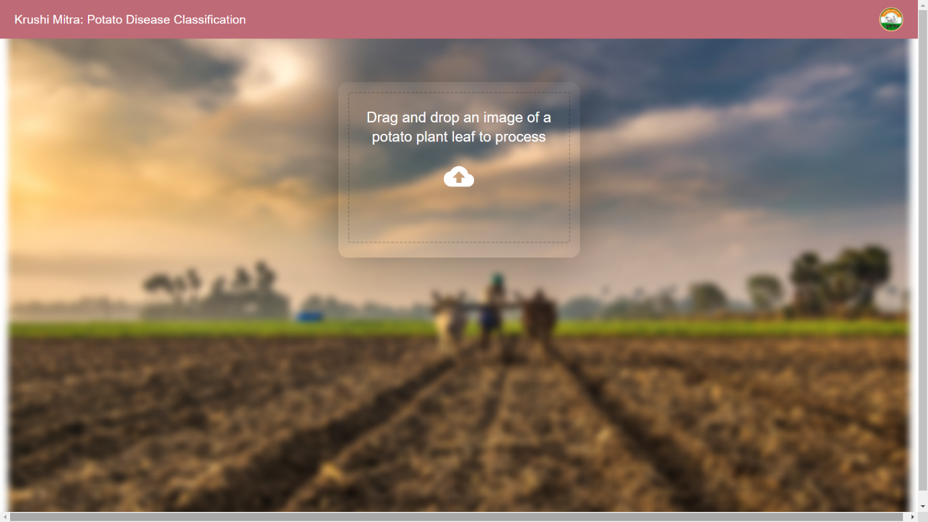
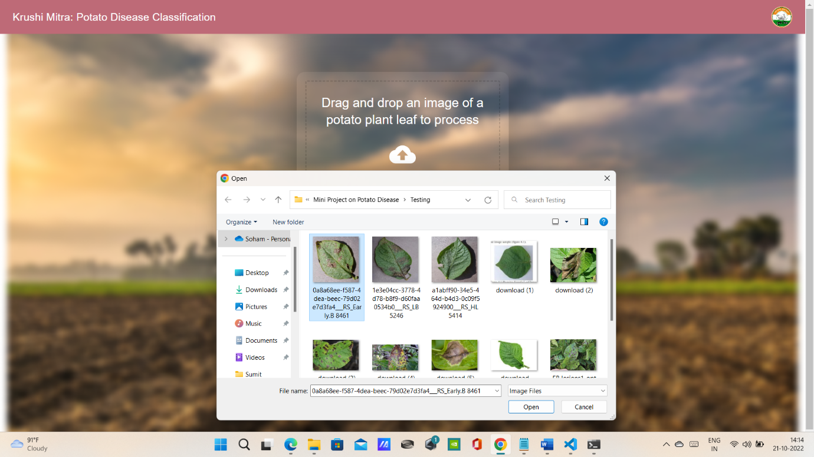
RESULTS
Krushi Mitra Website
Drag and drop of the image for testing

Slide 19
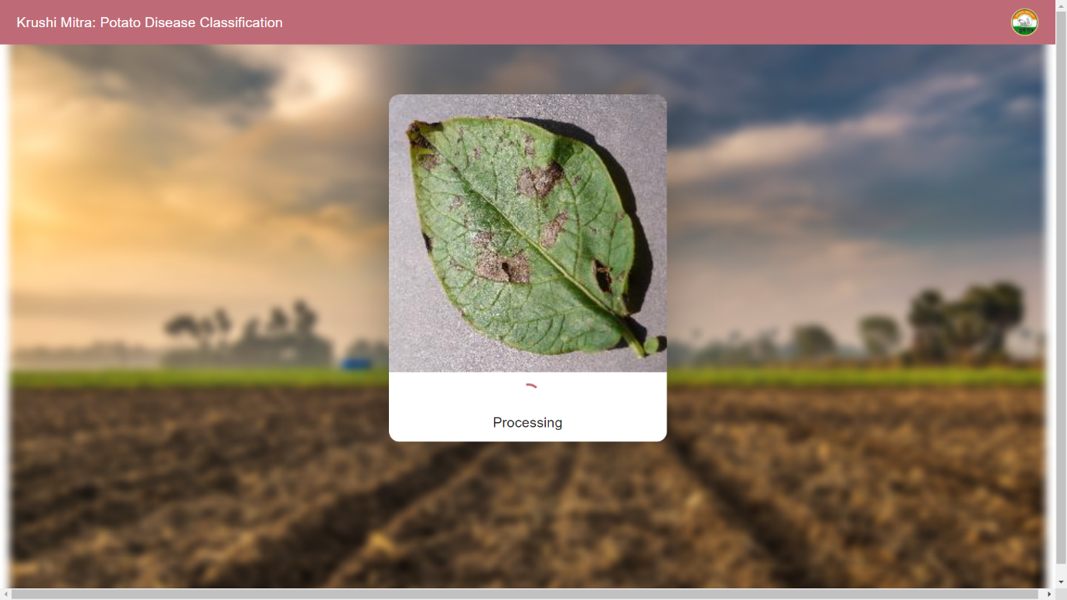
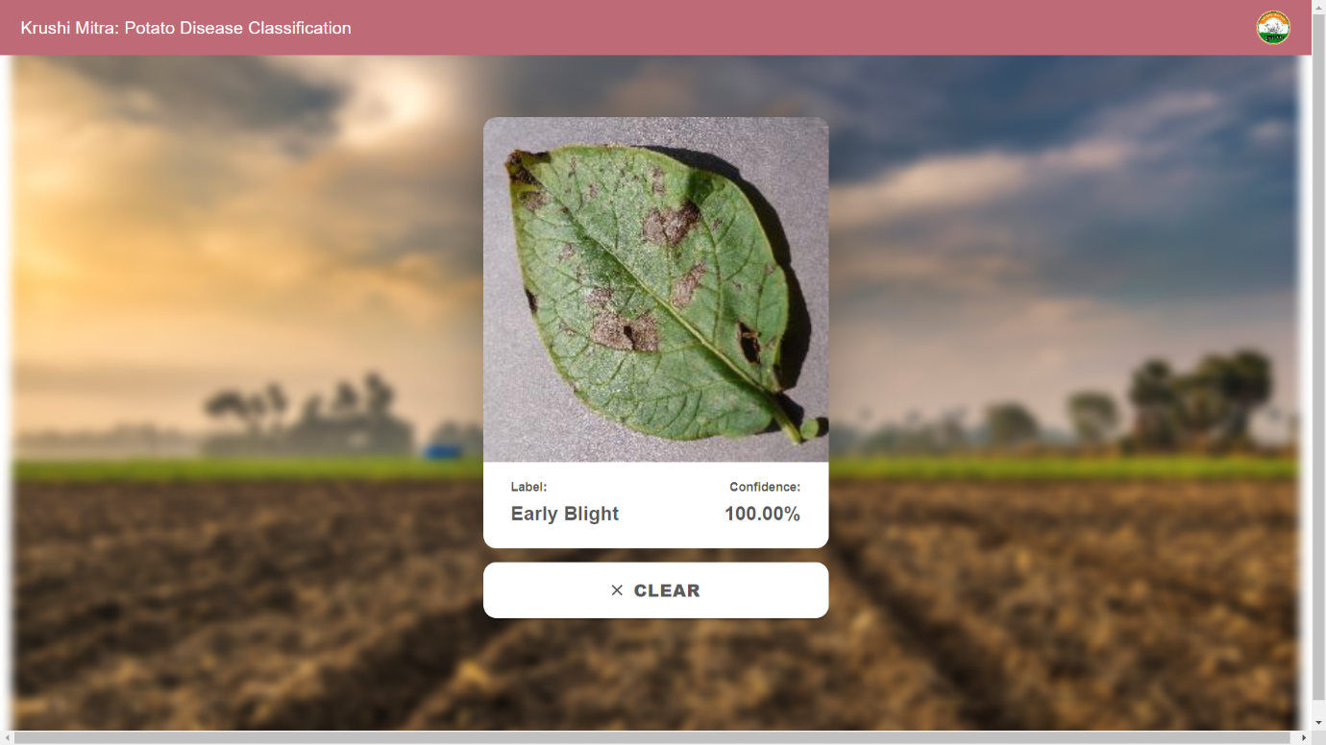
RESULTS
Image is in the process of testing
Predicted result of the image

Slide 20
REFERENCES
Lightweight Model for Leaf Classification and Disease Detection using TensorFlow Richard Hortizuela School of Advanced Studies Saint Louis University Baguio City, Philippines 2206385@slu.edu.ph
Plant Disease Detection Using CNN 1Sumit Kumar, 2Veerendra Chaudhary, 3Ms. Supriya Khaitan Chandra 1,2,3Dept. of Computer Science and Engineering, Glagotias University, India, Uttar Pradesh
Plant Leaf Disease Detection and Classification using Image Processing Author(s): *1 Yin Min Oo, 2Nay Chi Htun, Affiliation(s): 1 Department of Information Technology, Pyay Technological University 2Department of Information Technology, Pyay Technological University *Corresponding Author: yinminoo.it.85@gmail.com,

Slide 21
Thank You !!!

